Slide 1
Soldier Health Monitoring and Position
Tracking System
By: Parithosh Dinesh Poojary (17BEC7050)
Guide: Dr.Suseela Vappangi

Slide 2
CONTENTS
Introduction
Objective
Progress schedule
Design
Simulation
Hardware Implementation
Final Product Implementation
Results
References
Project Schedule

Slide 3
INTRODUCTION
In today’s era, enemy warfare is an important factor in any nation’s security.
The national security mainly depends on Army, Navy and Air-Force. The important and vital role is played by the soldiers.
So, to support this technological idea, in this project I have come up with a system which will track soldiers position as well as give their health status during a operation/mission.
This system in particular will be useful for individuals, who involve in missions or in special operations.

Slide 4
OBJECTIVE
To track the location and monitor the health of the soldier in real time, who get lost and injured in the battlefield, and also to minimize the time of search and rescue operation efforts of army control unit.

Slide 5
APPLICATIONS
DEFENCE FORCES
The project can be implemented in battle field or high altitude areas where health and location of soldiers is the most basic information which should be known to the control room.
CIVILIANS
This project can also be utilized by individuals who work in remote areas or high altitudes wherein the most basic information should be known to someone dear to them or their guardian’s.

Slide 6
PROGRESS SCHEDULE
OCTOBER 03, 2020
HARDWARE IMPLEMENTATION
Implementing the whole project with the acquired hardware components.
NOVEMBER 01, 2020
TESTING/IMPROVEMENTS
Testing of the designed hardware model, and if any improvements required, adding it accordingly.
NOVEMBER 15, 2020
FINAL PRODUCT IMPLEMENTATION
Simulation of the whole project based on the final draft of the design.

Slide 7
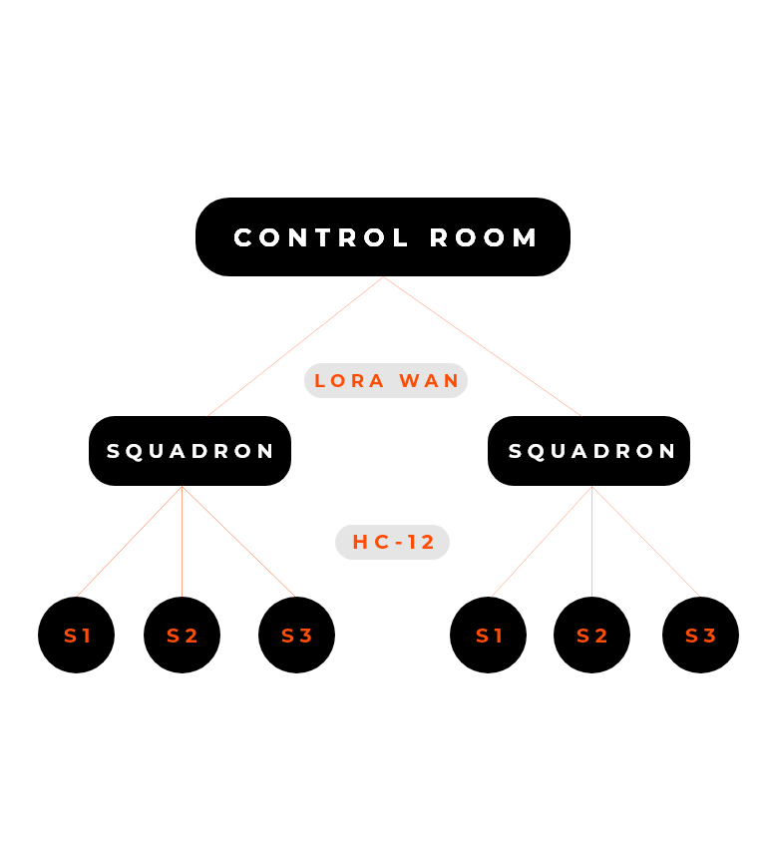
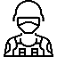


DESIGN
S1,S2,S3 - Soldiers
Soldiers play a key role in the whole system – they are equipped with multiple sensors ..i.e. Temp sensor (LM-35), Pulse sensor (RC-A-4015), GPS sensor (Neo-6M), RF transmitter (HC-12) and an Arduino UNO.
Squadron Leader
Squadron leader is placed at level 2, so that information is received to him before it is received to the control room, as in to take action quite earlier if by any chance some mishap occurs. The squadron leader would also be equipped with sensors ..i.e. RF receiver (HC-12), Temp sensor(LM-35), LoRa WAN transmitter (SX-1278) and an Arduino UNO.
Control Room
Control room is level 3, where all the information received through the LoRa WAN (SX-1278) is stored in a place.

Slide 8
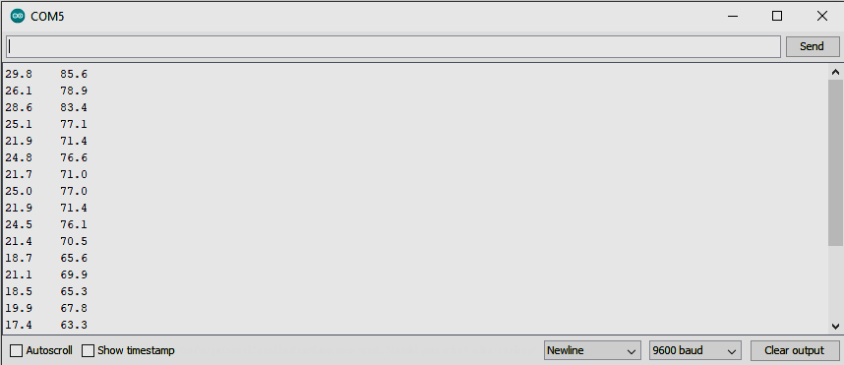
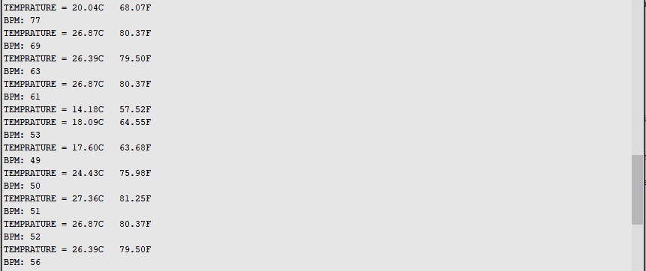
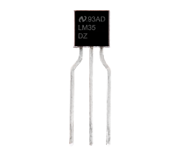
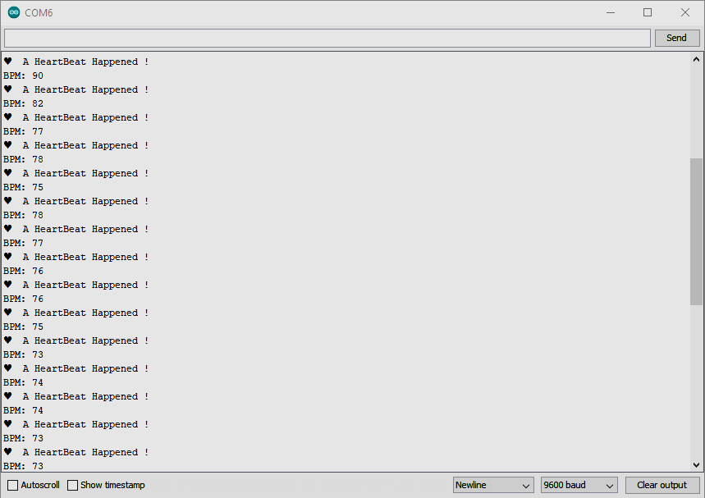
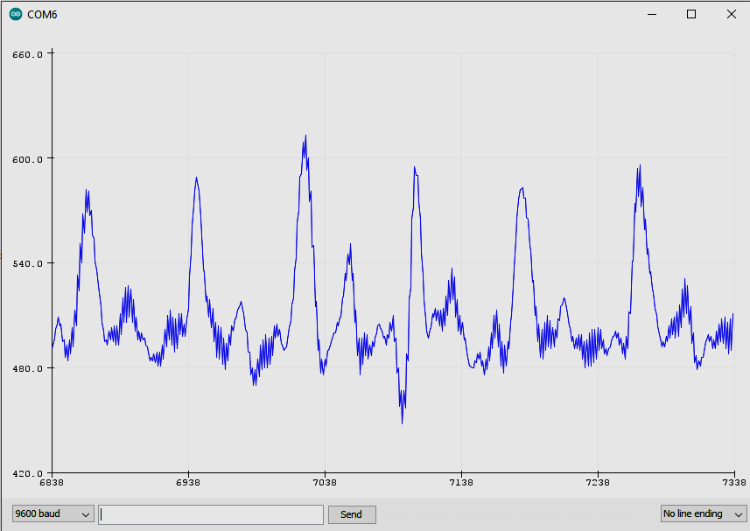
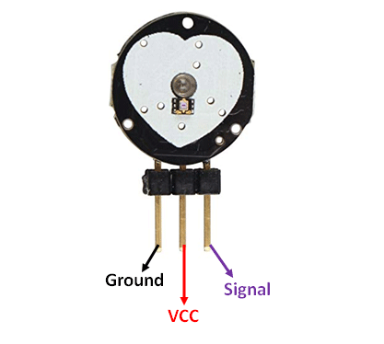
SIMULATION
Temp Sensor (LM-35)
LM-35 is a precession integrated circuit Temperature sensor, whose output voltage varies, based on the temperature around it. It is a small and cheap IC which can be used to measure temperature anywhere between -55°C to 150°C.
LM-35
(LM-35) + (RC-A-4015)
Pulse Sensor (RC-A-4015)
A pulse wave is the change in the volume of a blood vessel that occurs when the heart pumps blood, and a detector that monitors this volume change is called a pulse sensor.
RC-A-4015 does the same work by using a led, which emits light and simultaneously receives the emitted light and accordingly processes the light to provide an analog value of the heartbeat.
RC-A-4015

Slide 9
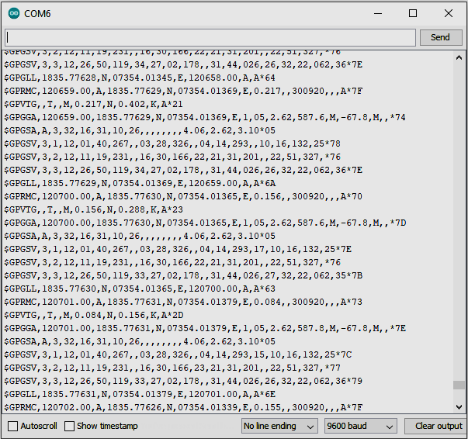
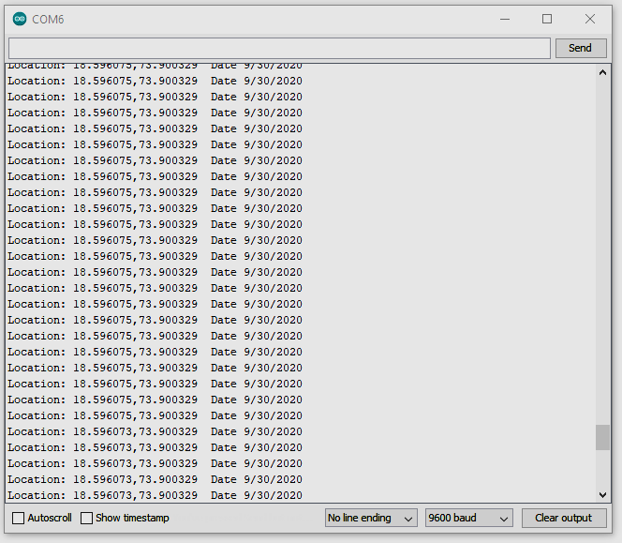
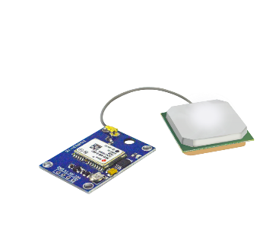
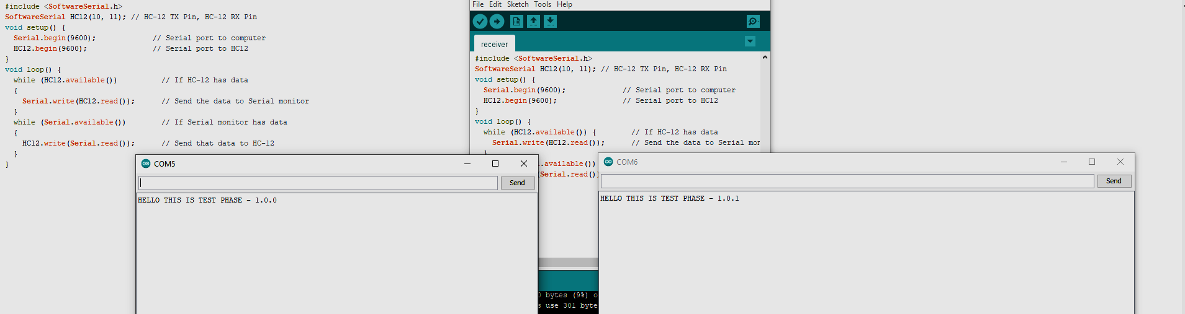
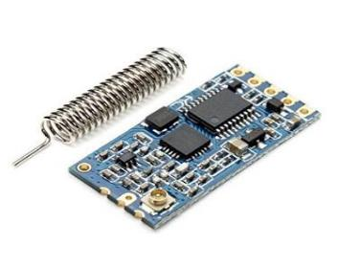
SIMULATION
GPS Sensor (Neo-6M)
GPS sensors are receivers with antennas that use a satellite-based navigation system with a network of 24 satellites in orbit around the earth to provide position, velocity, and timing information.
Neo-6M (NMEA Data)
Neo-6M(Lat, Lon and Date Data)
RF Sensor (HC-12)
The HC-12 is a half-duplex wireless serial communication module with 100 channels in the 433.4-473.0 MHz range that is capable of transmitting up to 1.5 km.
HC-12 (Transmitter and Receiver)

Slide 10
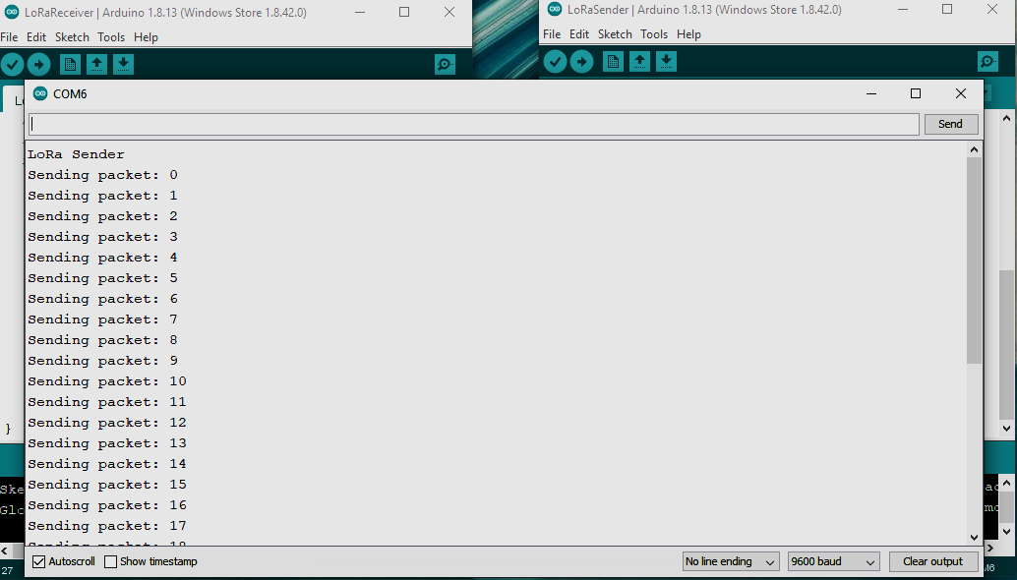
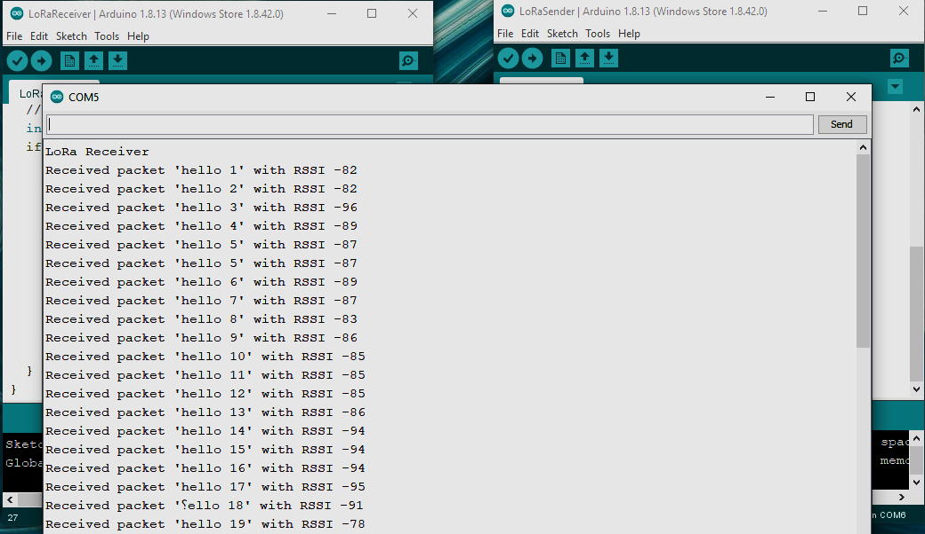
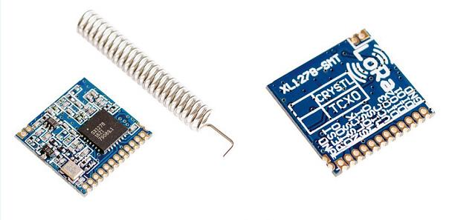
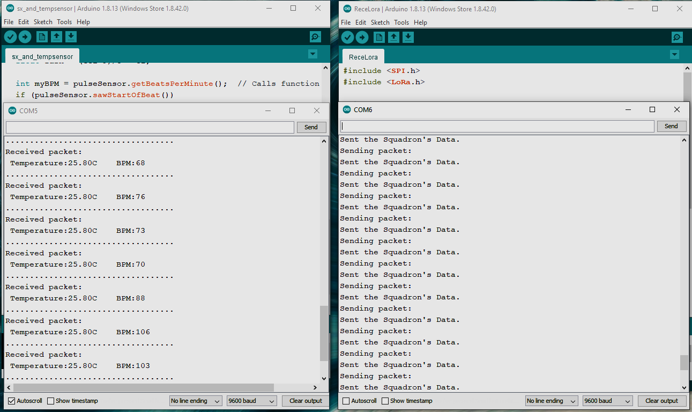
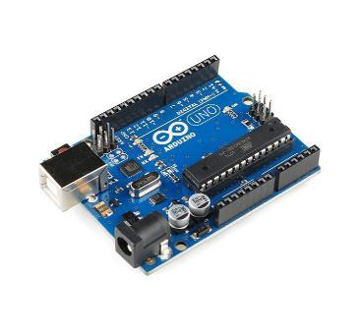
SIMULATION
LoRa WAN (SX-1278)
The SX1278 RF module is mainly used for long-range spread spectrum communication. It has minimum current consumption. Due to the LoRa modulation technology, the SX1278 has a high sensitivity of -148 dBm with a power output of +20 dBm, a long transmission distance and high reliability.
SX-1278 (Sender’s Data)
SX-1278(Receiver’s Data)
Micro-Controller (Arduino Uno)
The Arduino Uno is a microcontroller board based on the microchip ATmega328P. The board is equipped with sets of digital and analog input/output pins that may be interfaced to various expansion boards and other circuits.
(SX-1278) + {(LM-35) + (RC-A-4015)}

Slide 11
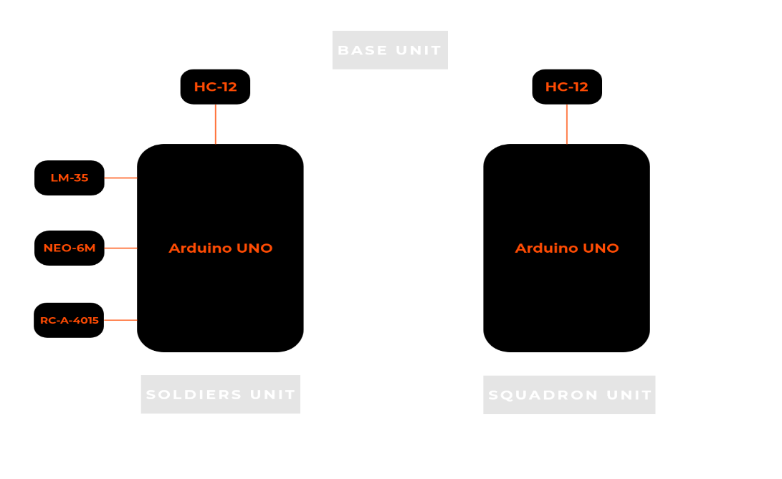
HARDWARE IMPLEMENTATION
Block diagram
Soldiers unit (Health and Position data) Squadron unit

Slide 12
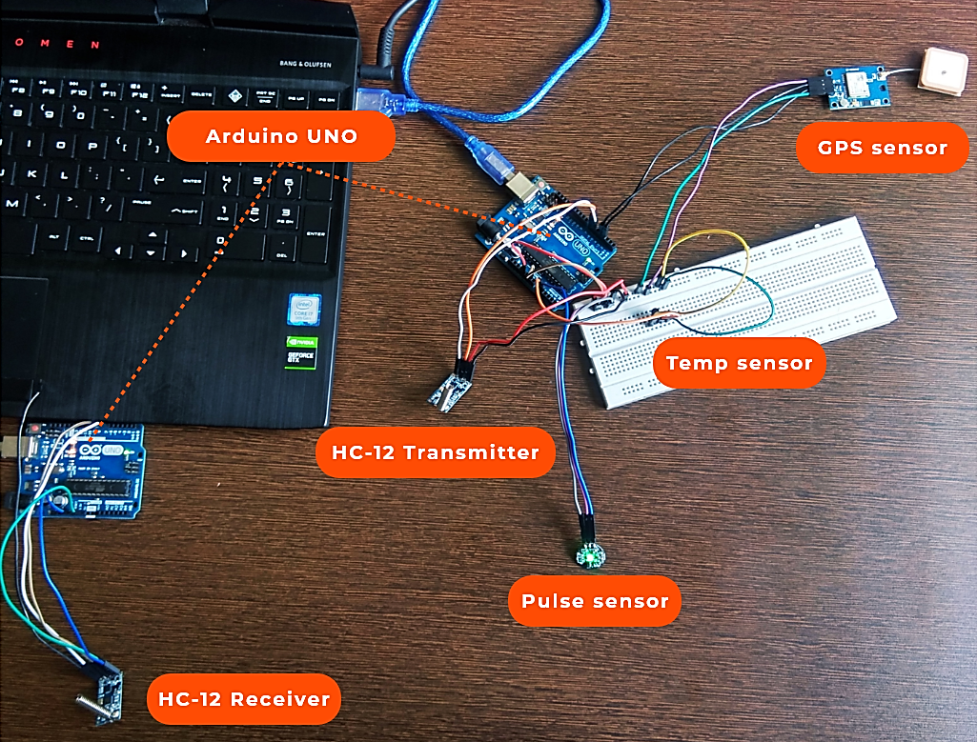
HARDWARE IMPLEMENTATION

Slide 13
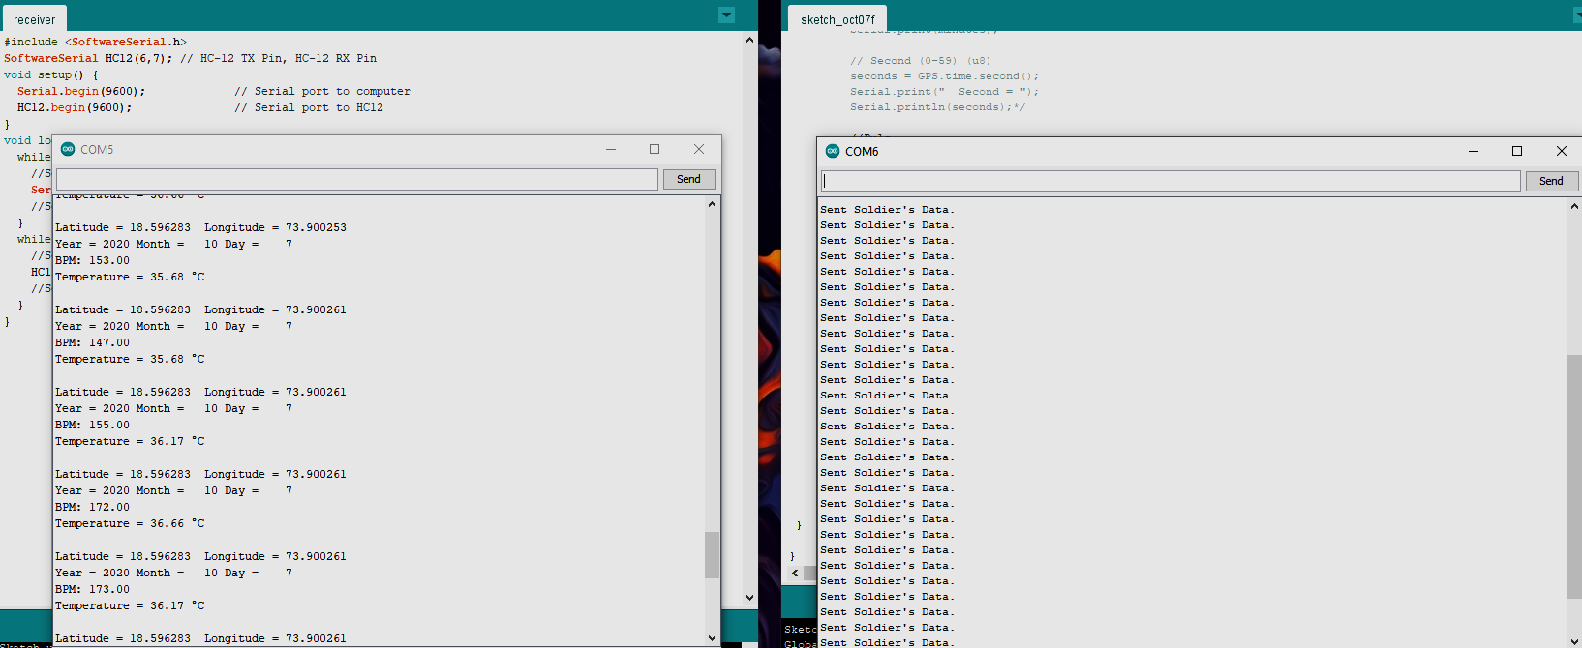
HARDWARE IMPLEMENTATION

Slide 14
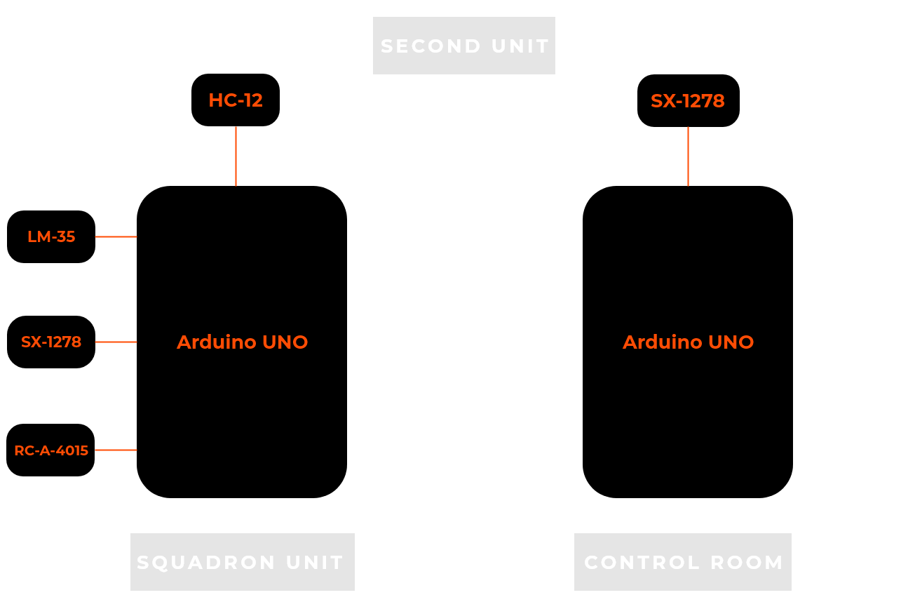
HARDWARE IMPLEMENTATION
Block diagram
Squadron unit (Health data) Control Room

Slide 15
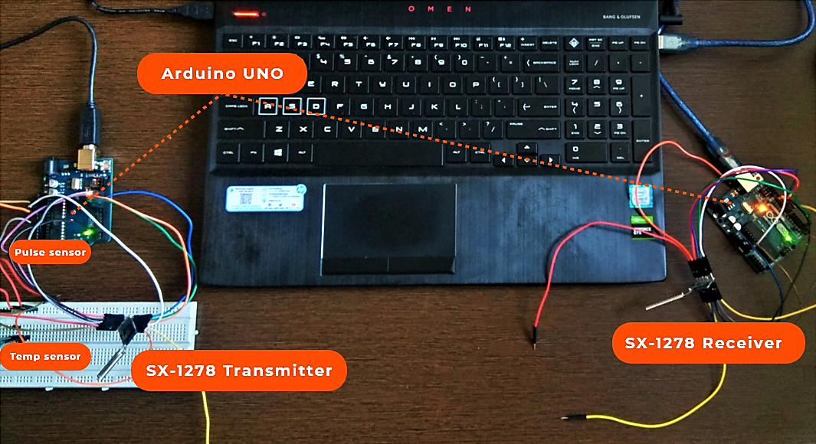
HARDWARE IMPLEMENTATION

Slide 16
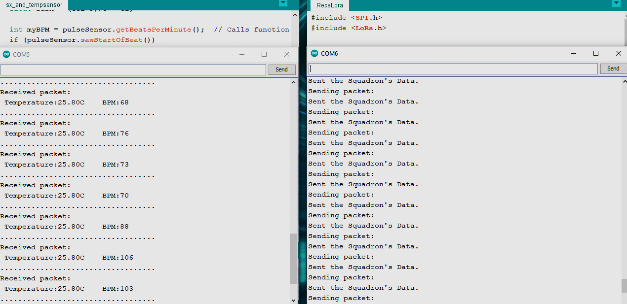
HARDWARE IMPLEMENTATION

Slide 17
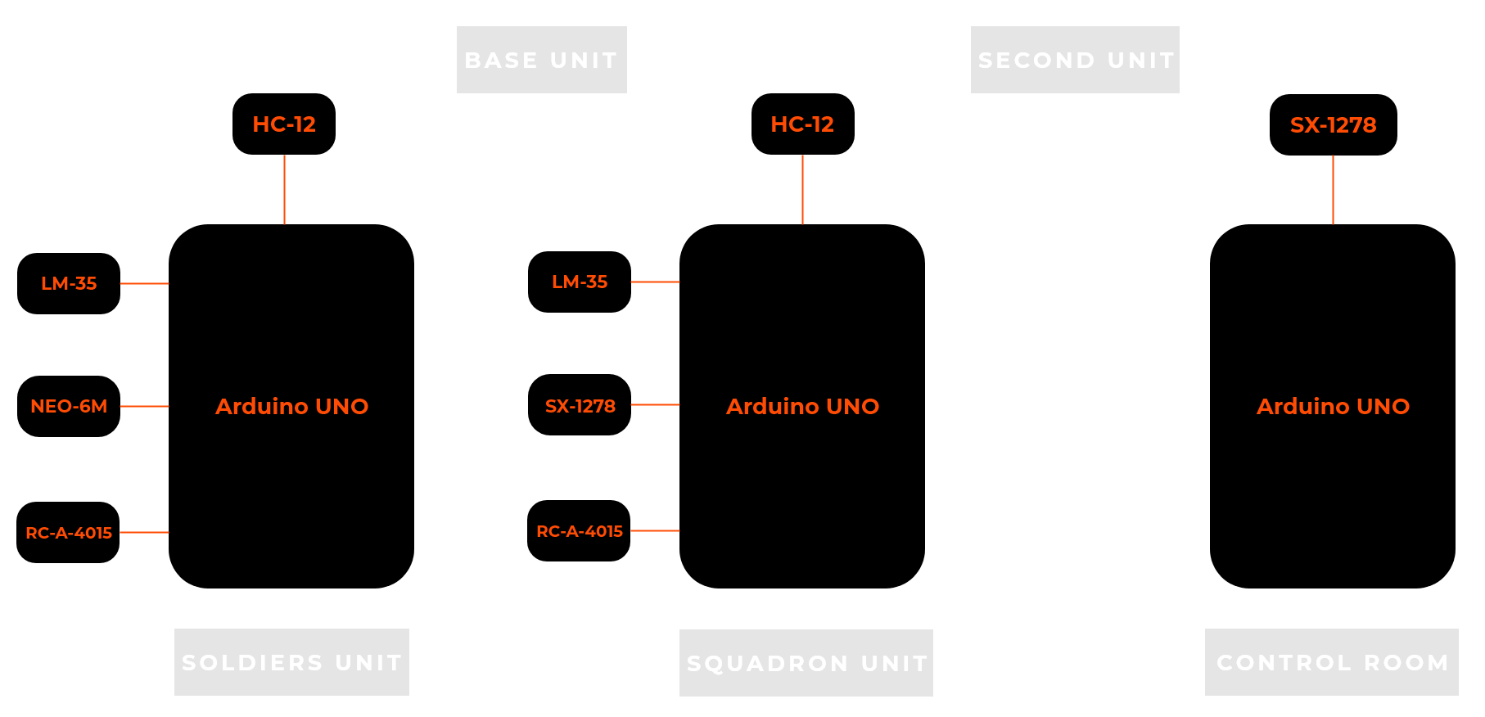
FINAL PRODUCT IMPLEMENTATION
Block diagram
Soldiers unit (Health and Position data) Squadron unit Control Room

Slide 18
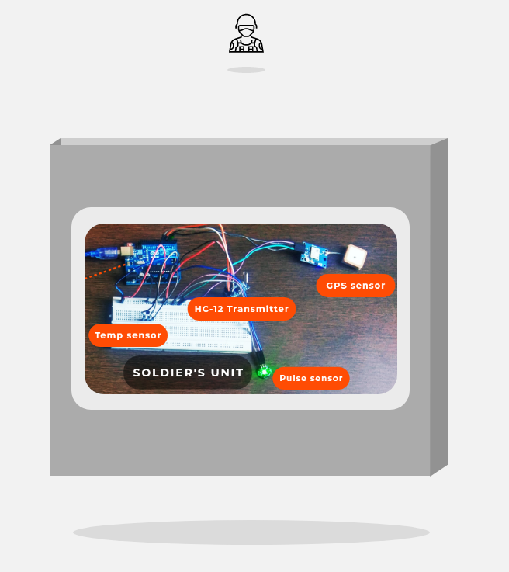
FINAL PRODUCT IMPLEMENTATION
SOLDIER’S PACK
Temp Sensor
Pulse Sensor
GPS Sensor
HC-12 Transmitter
Arduino UNO

Slide 19
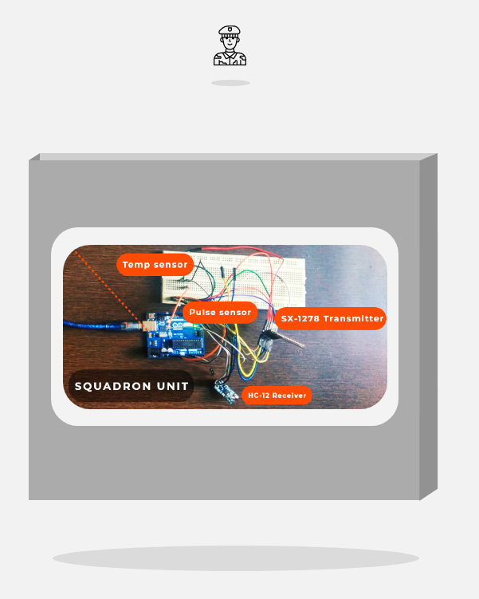
FINAL PRODUCT IMPLEMENTATION
SQUADRON’S PACK
Temp Sensor
Pulse Sensor
SX-1278 Transmitter
HC-12 Receiver
Arduino UNO

Slide 20
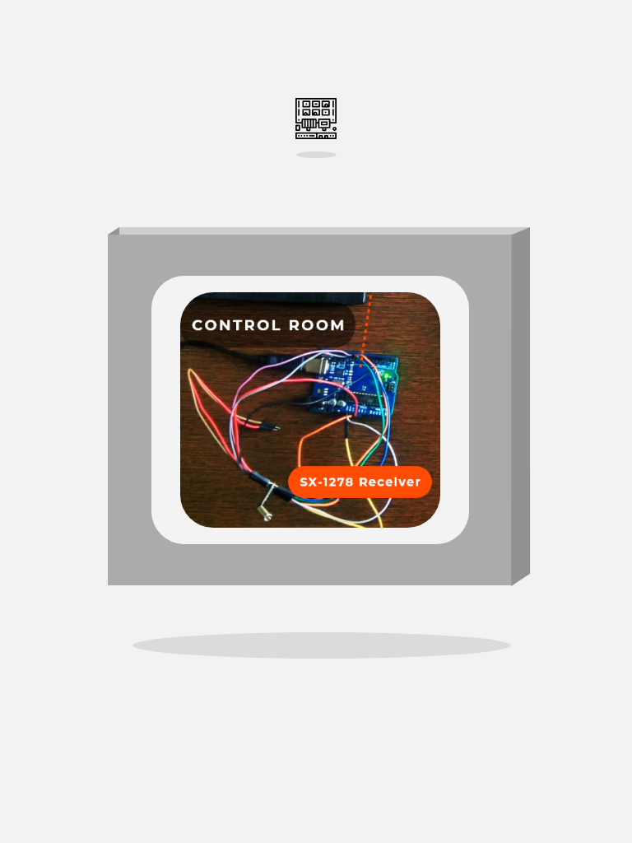
FINAL PRODUCT IMPLEMENTATION
CONTROL-ROOM PACK
SX-1278 Receiver
Arduino UNO

Slide 21
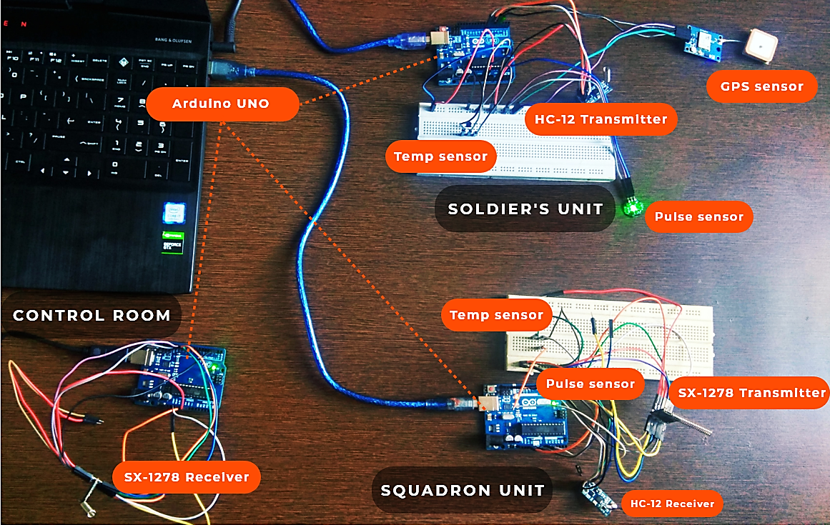
FINAL PRODUCT IMPLEMENTATION

Slide 22
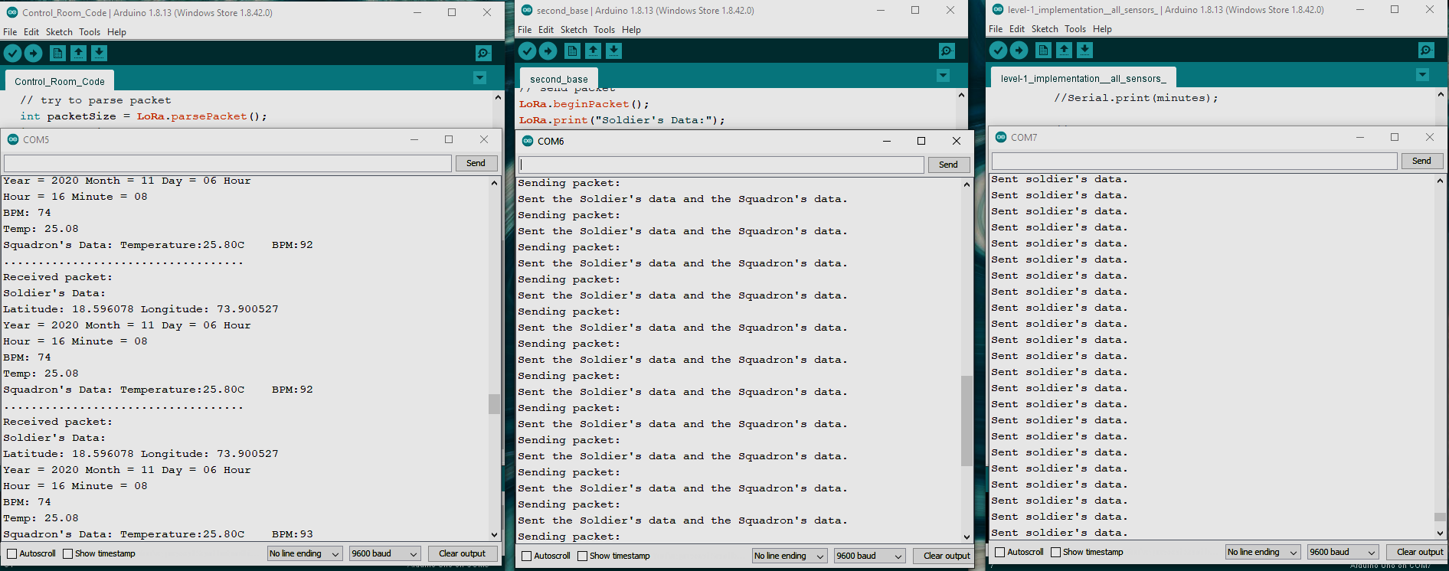
FINAL PRODUCT IMPLEMENTATION

Slide 23
RESULT
Successfully designed a model that meets the requirement of my objective.
Successfully simulated all the acquired components.
Successfully simulated all the level’s of the design..i.e. sending the data collected from the soldiers S-Health system to the squadron’s unit through RF module(HC-12) and simultaneously sending the data received from soldiers unit combined with the data of the squadron unit to the control room through the LoRa module(SX-1278).

Slide 24
REFERENCES
Hock Beng Lim, Di Ma, Bang Wang, Zbigniew Kalbarczyk, Ravishankar K. Iyer, Kenneth L. Watkin (2010); “A Soldier Health Monitoring System for Military Applications”.
William Walker, A. L. Praveen Aroul, Dinesh Bhatia; “Mobile health monitoring system”.
Shweta Shelar, Nikhil Patil, Manish Jain, Sayali Chaudhari, Smita Hande; “Soldier Tracking And Health Monitoring Systems”.
P.S. Kurhe, S.S. Agrawal (2013); “Real Time Tracking and Health Monitoring System of Remote Soldier Using ARM 7”.
www.allaboutcircuits.com/projects/understanding-and-implementing-the-hc-12-wireless-transceiver-module
https://circuitdigest.com/microcontroller-projects/arduino-lora-sx1278-interfacing-tutorial

Slide 25
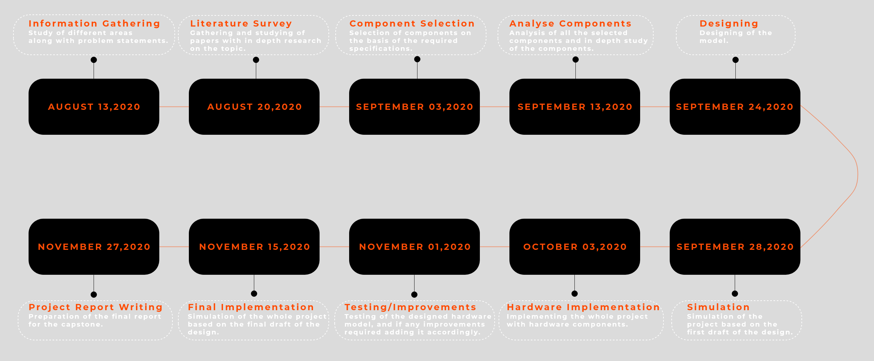
PROJECT SCHEDULE

Slide 26
THANK YOU
ANY QUESTIONS ?

